Slide 1
Data-Driven Insights for Digital Marketing Campaigns
6th Grade
Leveraging Analytics to Optimize Campaign Performance
Dhruv
Business & Marketing Analyst Trainee – GUVI

Slide 2
Table of contents
01
02
03
04
Introduction and Project Overview
Data Cleaning and Preparation
Brief overview of the project objectives, tools used, and overall analytical approach.
Cleaning and formatting Excel sheets to ensure accurate, structured, and analysis-ready data.
Data Visualization and Analysis in Power BI
Recommendations & Strategic Insights
Building interactive dashboards to analyze marketing performance and key user metrics.
Summarizing key findings from the dashboard to optimize campaigns and improve ROI.

Slide 3
Introduction and Project Overview
Project Objective:
The goal of this project is to evaluate and enhance digital marketing performance across multiple channels using data-driven insights. The analysis focuses on understanding user behavior, engagement trends, and campaign effectiveness.
Tools and Techniques Used:
Excel: Data cleaning, transformation, and formatting across 10 datasets.
Power BI: Dashboard creation, visual storytelling, and KPI tracking.
Statistical Analysis: Used to uncover hidden trends and derive actionable insights.

Slide 4
Approach:
The project was divided into three key tasks:
Data Cleaning and Preparation – Ensuring data accuracy and consistency.
Data Visualization and Analysis in Power BI – Building interactive reports.
Insights and Recommendations – Deriving conclusions to enhance campaign performance.
Outcome:
A structured and visually interactive dashboard highlighting user engagement, traffic sources, and revenue performance — supporting smarter, data-driven marketing decisions.

Slide 5
Data Cleaning and Preparation
01
Transforming raw marketing data into structured, analysis-ready insights.

Slide 6
Objective: To prepare and standardize Excel dataset for accurate, consistent, and Power BI–ready analysis.
Key Steps Performed:
Standardized column headers across all sheets for consistency (e.g., New_Users, Event_Count, Avg_Engagement_Time_(sec)).
Converted text fields to numeric format and formatted percentages & decimals for analytical accuracy.
Transformed engagement time into seconds using a uniform conversion formula for consistent analysis.
Removed currency symbols ($) and labeled columns with (USD) for clarity without losing numeric type.
Cleaned and formatted text fields – trimmed spaces, corrected capitalization, and unified naming styles.
Handled invalid rows while retaining “(not set)” and “Unknown” to highlight data tracking gaps in analysis.
Removed duplicate records and recreated serial numbers to maintain table integrity.
Validated all data types and totals across 10 sheets to ensure readiness for Power BI import.
Result: A clean, structured, and analysis-ready dataset ensuring accurate insights and seamless Power BI integration.

Slide 7
02
Data Visualization and Analysis in Power BI
Transforming cleaned data into interactive dashboards for actionable marketing insights.

Slide 8
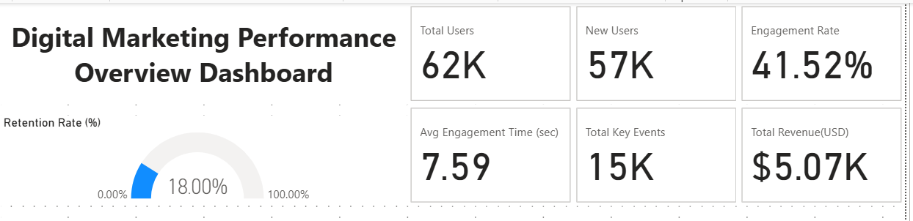
Marketing Performance KPIs
The platform recorded 62K total users and 57K new users, indicating a strong acquisition performance, especially from new user growth.
An engagement rate of 41.5% with an average engagement time of 7.59 seconds shows users are actively interacting with the content.
Total key events (~15K) and revenue of $5.07K reflect moderate conversion effectiveness, while a retention rate of 18% highlights room to strengthen user loyalty.

Slide 9
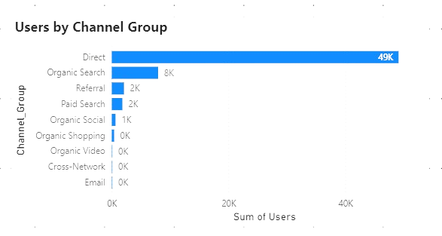
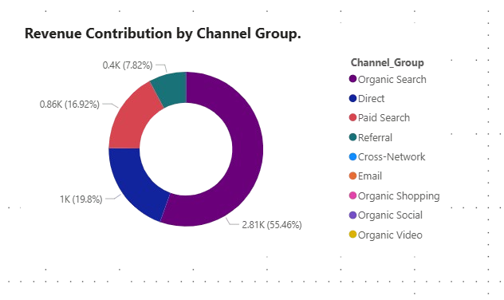
Title: Users by Channel Group
Title: Revenue Contribution by Channel Group
Direct traffic leads with 49K users, indicating strong brand presence and users accessing the platform directly.
Organic Search adds 8K users, showing solid SEO performance and visibility through search engines.
Channels like Referral (2K), Paid Search (1.8K) and Social (681) show room for growth — indicating an opportunity to expand reach through diversified acquisition strategies.
Organic Search drives the highest share of revenue (≈55%), showing strong performance from unpaid search visibility and SEO efforts.
Direct traffic contributes nearly 20%, highlighting brand recall and loyal visitors directly accessing the site.
Paid Search and Referral bring in smaller portions (17% and 8%), suggesting potential to boost ad ROI and strengthen referral partnerships.

Slide 10
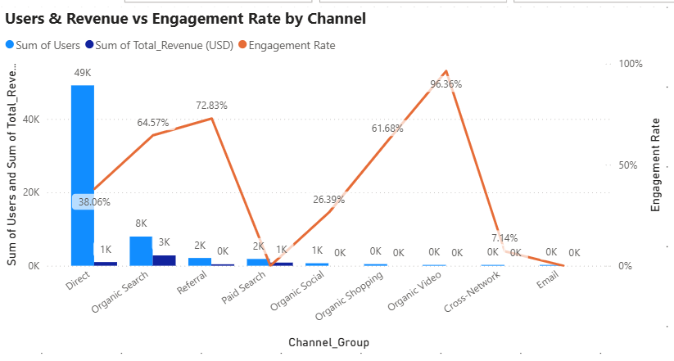
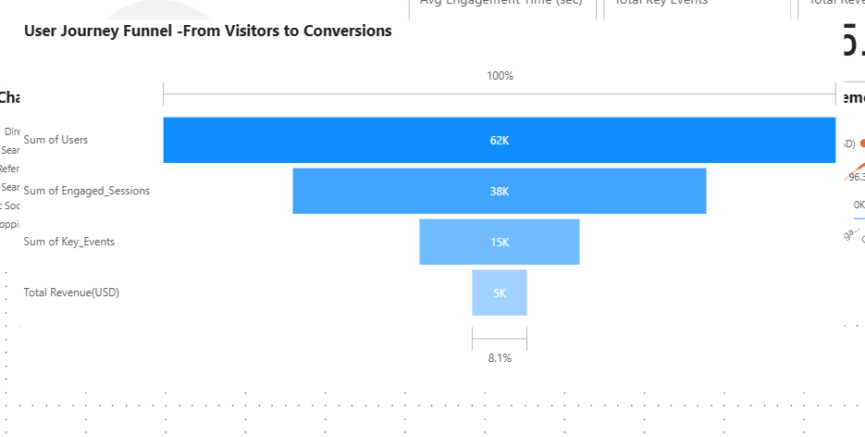
Title: Users & Revenue vs Engagement Rate by Channel
Title: User Journey Funnel – From Visitors to Conversions
Out of 62K users, only 38K (61%) engaged — showing that 4 in 10 visitors drop off early, highlighting the need to improve first-time engagement.
About 15K (24%) triggered key events, indicating moderate interaction but room to drive more intent-based actions.
Only a small share of users end up generating revenue — so the conversion stage must be optimized.
Direct and Organic Search drive the most users and revenue, but Direct’s lower 38% engagement suggests room to boost interaction quality.
Organic Video shows the highest engagement (96%), proving strong audience retention despite limited reach.
Paid Search and Referral deliver moderate engagement (65–73%), showing potential for scalable performance with campaign tuning.

Slide 11
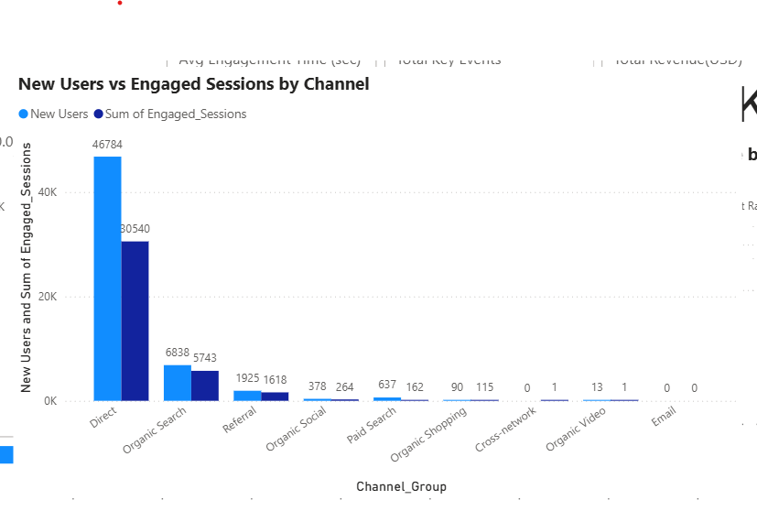
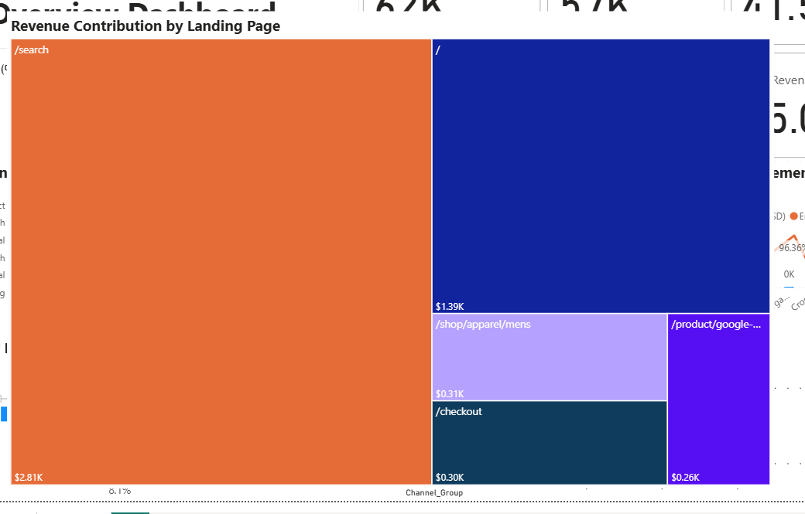
Title: User Engagement Efficiency by Marketing Channel
Title: Revenue Contribution by Landing Page
Direct: 46.7K new users → 30.5K engaged sessions — strongest volume and engagement conversion due to high brand visibility.
Organic Search: 6.8K new users → 5.7K engaged sessions — highest engagement efficiency, meaning SEO users arrive with strong intent.
Referral & Paid Search: lower volumes but healthy engagement conversion — good candidates to scale with targeted investment.
The /search page generates the highest revenue ($2.81K, ~55% of total), making it the key entry and conversion driver.
The home page (“/”) and /shop/apparel/mens together contribute another $1.7K, strengthening mid-funnel engagement.
Pages like /checkout and /product pages have smaller revenue shares, indicating scope to optimize checkout flow and product CTAs.

Slide 12
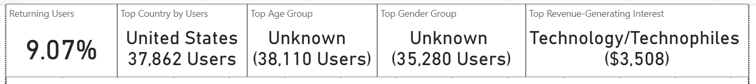
Audience & Demographic Overview KPIs
Returning Users (9.07%) indicate low repeat engagement, showing scope to improve retention.
United States dominates with 37,862 users, confirming it as the strongest and most active market.
Technology/Technophiles drive the highest revenue ($3.5K), marking them as a key audience segment for premium targeting.
Age and Gender groups appear as Unknown, Collecting demographic info can unlock more precise segmentation and targeted campaigns.

Slide 13
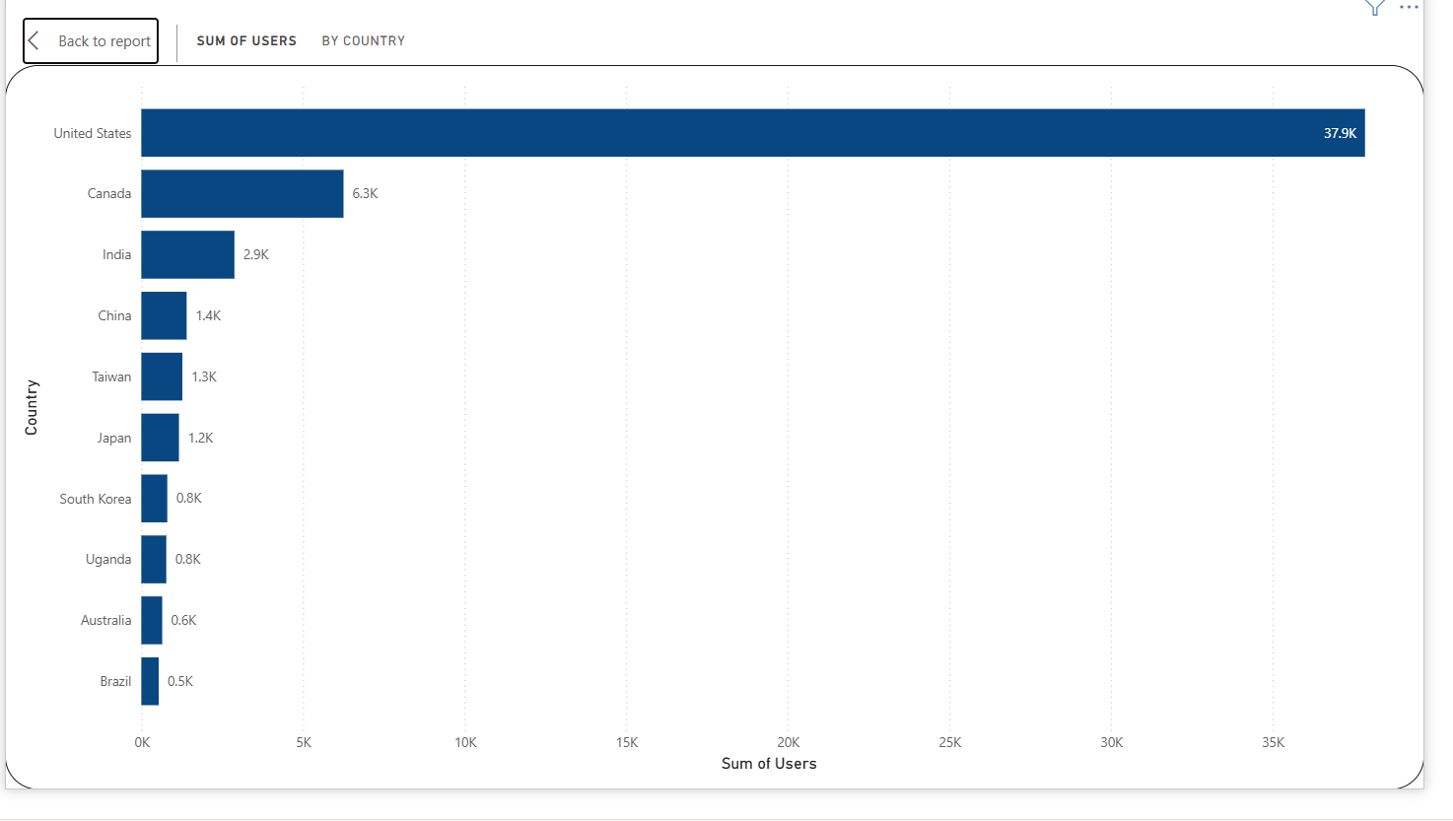
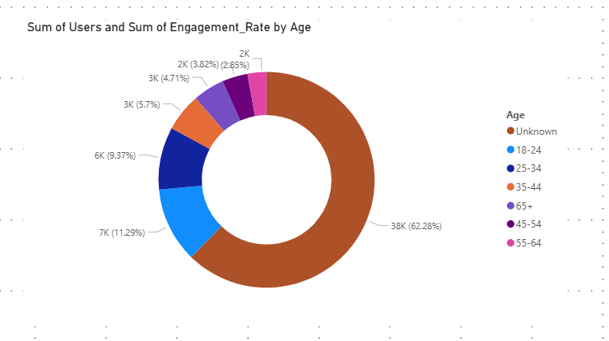
Title: Top Countries by Users
Title: User Distribution by Age Group
United States contributes the highest users (~38K), making it the primary target market.
Canada and India follow, indicating strong audience presence in North America and emerging traction in Asia.
Lower volumes from regions like China, Japan, and Australia signal opportunities for localized marketing strategies.
The ‘Unknown’ category dominates with 62% of total users, highlighting missing demographic data that limits targeted analysis.
18–24 (11%) and 25–34 (9%) are strong digital consumer groups, representing high-value and engagement-prone audiences.
Lower adoption among older users (35–65+) indicates market growth potential with age-tailored messaging.

Slide 14
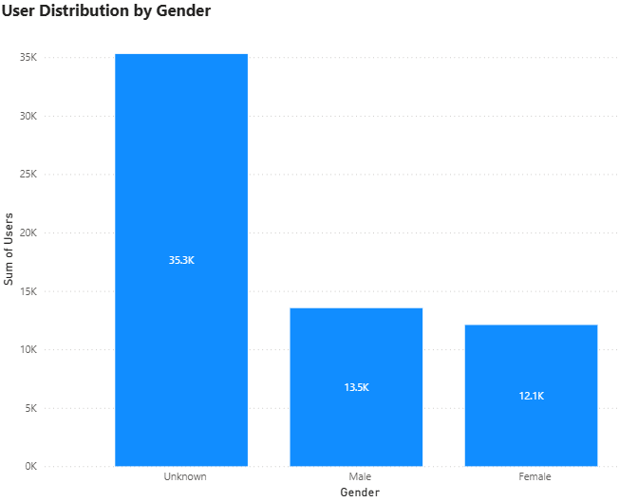
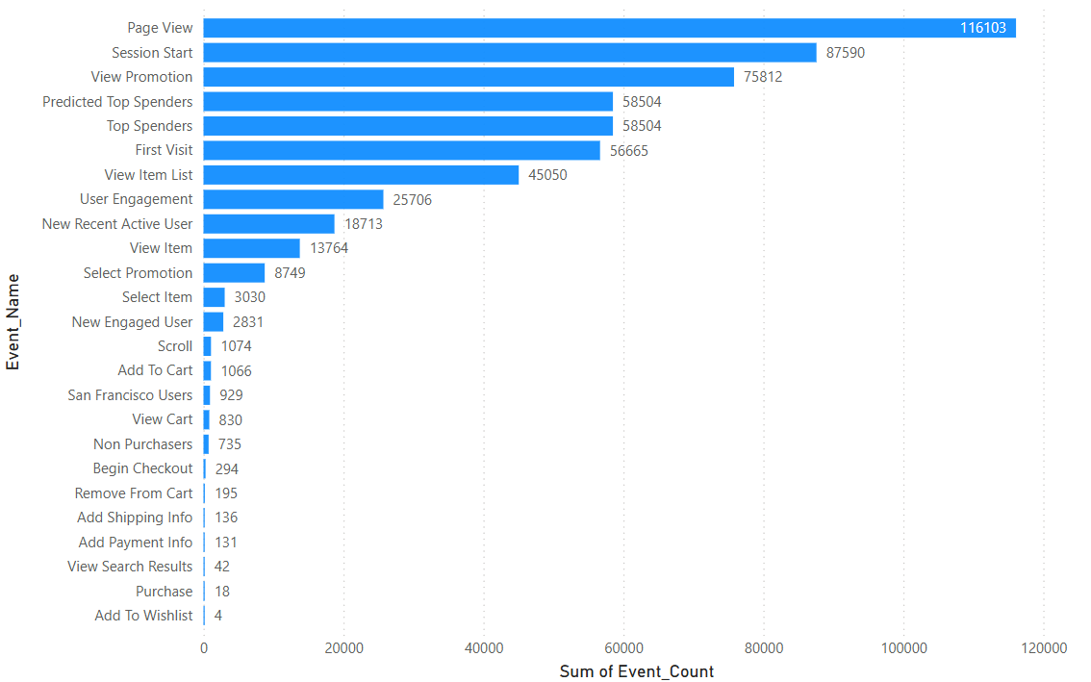
Title: User Distribution by Gender
Title: Event Count by Event Type
The “Unspecified” gender category accounts for the largest share (35.3K users), possibly due to privacy preferences or unavailable data.
Among identified users, Male (13.5K) and Female (12.1K) distributions are relatively balanced.
Ensuring more detailed demographic capture can enhance personalized targeting and audience segmentation.
Page View and Session Start dominate user activity, indicating strong initial engagement and browsing behavior.
Promotion-related events like View Promotion and Select Promotion show healthy interaction, reflecting effective marketing reach.
Low purchase and checkout events suggest drop-offs at later funnel stages, highlighting an opportunity to improve conversion strategies.

Slide 15
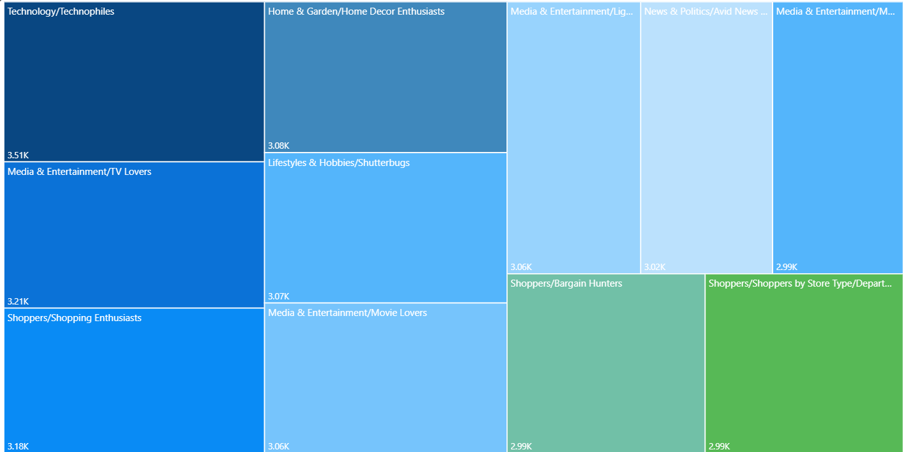
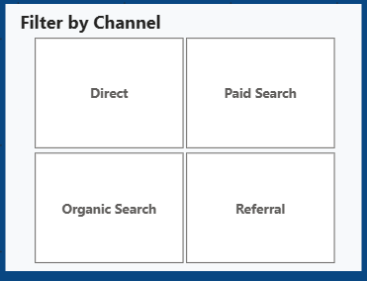
Title: Revenue Contribution by Interest Category
Title: Interactive Channel Filter
Technology, Media & Entertainment, and Lifestyle/Hobbies drive the highest revenue, showing strong monetization potential.
Engagement rates (≈45–55%) stay consistent across most interests, reflecting steady user activity.
Top 10 segments contribute most of the revenue, making them prime audiences for targeted high-ROI campaigns.
Added Channel slicer for interactive analysis across all visuals.

Slide 16
Recommendations & Strategic Insights
03
Data-driven recommendations to enhance engagement, conversions, and audience targeting.

Slide 17
Marketing Performance Recommendations
1 Optimize Channel Mix
Strengthen top-performing channels like Organic Search and Direct with consistent SEO and content efforts.
Reallocate budget toward Paid and Social channels that show potential but low reach.
2 Boost Engagement Across Touchpoints
With an average engagement rate of 41%, improve landing page experience and interactive content to increase time-on-site.
Implement A/B testing for headlines, visuals, and CTAs to reduce early exits.
3 Improve Funnel Conversions
Monetization is just 8.1% relative to total traffic, indicating significant revenue leakage at the final purchase stage — retargeting and checkout improvements can help recover lost revenue.
Simplify checkout and form processes to reduce drop-offs between engagement and purchase.
4 Strengthen Retention & Re-engagement
Launch loyalty programs and email follow-ups to raise the retention rate beyond 18%.
Use remarketing to bring back disengaged or one-time visitors.

Slide 18
Audience & Demographic Recommendations
1 Focus on High-Value Regions
Prioritize the United States (~38K users) where CAC/LTV is favorable.
Localize campaigns for Canada and India to scale efficiently.
2 Enhance Demographic Data Tracking
Large “Unknown” segments in age and gender reduce targeting accuracy — integrate user sign-ups or analytics tagging for clearer audience insights.
3 Leverage Interest-Based Marketing
Target high-revenue interest groups — Technology, Media, and Lifestyle — with specialized campaigns.
Use segment-specific creatives/LPs and A/B test offers to lift conversion and ROAS.
4 Personalize User Engagement & Retention
Trigger remarketing for view-item, add-to-cart, and checkout-abandon cohorts.
Build lifecycle journeys (welcome, nurture, win-back) to increase returning users and retention.

Slide 19
Thank You!

